Slide 1
Viral
infections in pregnancy
by Jade Murray

Slide 2
Viral infections
Virus’s such as Cytomegalovirus (CMV), Varicella-Zoster Virus (VZV, Chicken Pox), Parvovirus, and Rubella are very common during a pregnancy.

Slide 3
Cytomegalovirus (CMV)
CMV is a DNA virus that is in the herpes family
Transferred through infected secretions
Is transferred to the fetus through mothers infected blood present in the placenta.
S&S: Flu like symptoms, Patients may also present with phenomena or hepatitis.
Effects on fetus: Placental infections, Impaired oxygenation & nutrient circulation that can lead to growth restrictions and in severe cases death.
Tx: Treating the symptoms

Slide 4
Varicella-Zoster Virus (Chicken Pox)
VZV also comes from the herpes family
Acquired form direct contact with lesions or from airborne transmission.
S&S: Headaches, fever, weakness, and of course an itchy fluid-filled rash, that occurs after the incubation period (10-14 days).
Effect on fetus: The risk of a spontaneous abortion, birth defects, growth restrictions, premature delivery, and fetal demise (growth) increases. If the virus is acquired closer to the due date it increases the potential of perinatal mortality.
Tx: Treating the symptoms & close monitoring of the fetus.

Slide 5
Parvovirus B19
Parvovirus B19 is the only parvovirus to infect humans. It’s composed of a single strand DNA and causes a variety of pathology including sickle cell disease, lack of red blood cell development, erythema infectionsum (reddening of the skin), myocarditis (inflammation of the heart muscle), and arthropathy (disease of the joints).
The virus is transmitted through respiratory droplets and can cross the placenta and infect the fetus.
S&S: Infected individuals may be able to transmit parvovirus before they know they have it. Other symptoms include flu-like symptoms and a “slapped-cheek” or “lace-like” rash around the mouth 2-5 days after exposure to the virus.
Effect on fetus: During a pregnancy the affect on the fetus is dependent on the gestational age. Infections in the first half of a pregnancy is associated with a worse outcome than in a later period.
Tx: Treat the symptoms & monitoring fetus

Slide 6
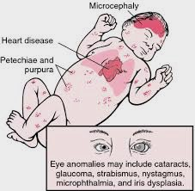
Rubella
Rubella is also known as the German measles or “the 3 day measles”
Transmission occurs through air droplets and requires close contact. The Virus enters the respiratory tract and travels to the cervical lymph nodes (in the neck) from there enters the blood stream and spreads throughout the body.
S&S: Signs and symptoms include low-grade fever, weakness, swollen lymph nodes, and a rash that lasts approximately 3 days. The virus is present in secretion and blood, but takes several days (2-3 week incubation period) before clinical signs and symptoms are present.
Effect on fetus: During a pregnancy, fetal transmission occurs via passage of virus from mothers blood to the placenta. Once the virus is inside the placenta it infects epithelial and endothelial cells and gains access to fetal circulation and organs. Rubella induces change of cell growth leading to cell death, tissue necrosis (death of tissue), and organ hypoplasia (lack of organ development).
Tx: None

Slide 7
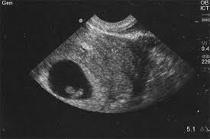
Overall prevention
WASH YOUR HANDS!!
Avoiding people that have these illnesses
Visit your OB/GYN frequently during your pregnancy
Prenatal vitamins & a healthy diet

